Slide 1
Sorghum Flower Detection
Alex Fish

Slide 2
About Me
Alex Fish
Math Major, CS Minor at UNO
Background in CS, strong interest in Machine Learning
Interests include computational math, optimization, machine learning
Currently in my final year of school, graduating August of 2019.
Applied to PhD schools for applied math.

Slide 3
Project Goal
Count and identify sorghum flowers in aerial photos using object-detection algorithms.

Slide 4
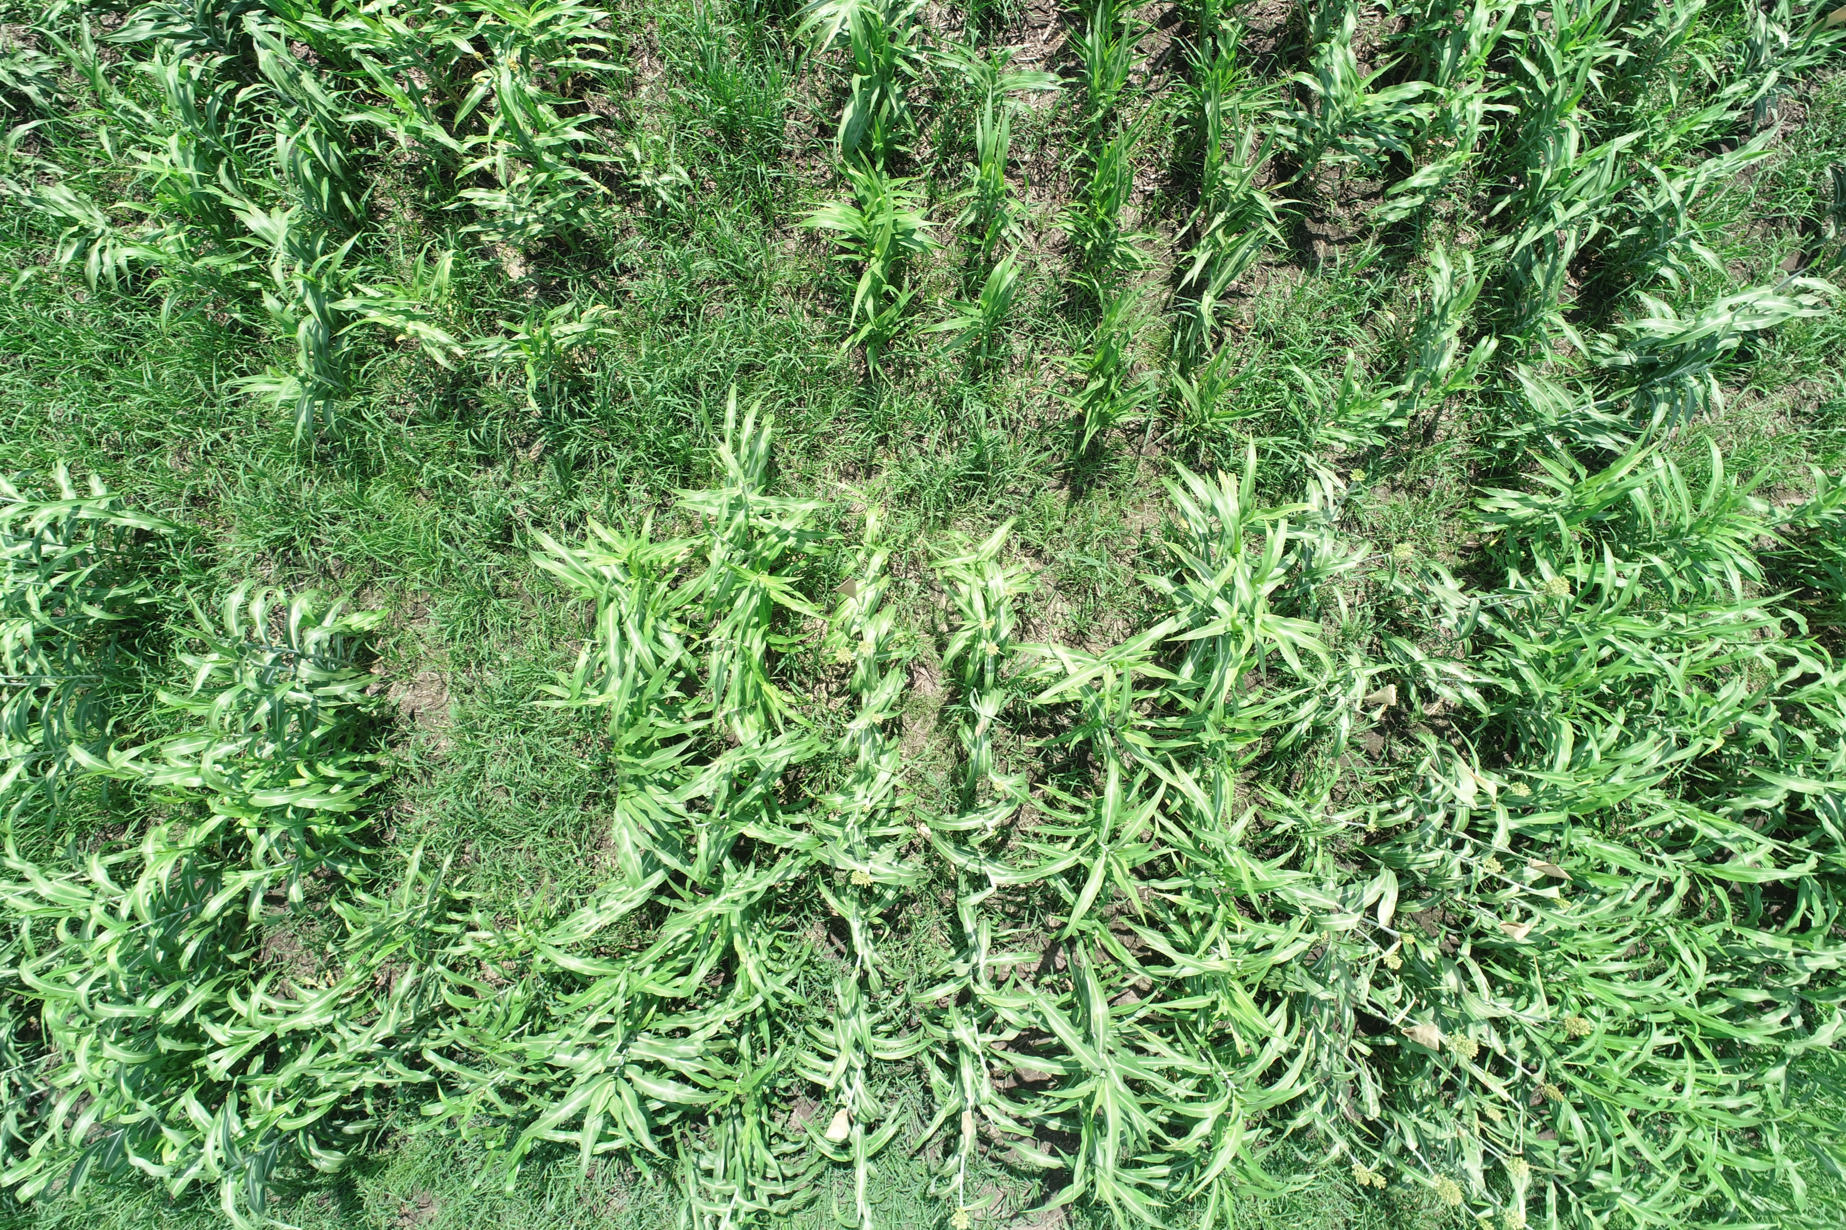

Slide 6
Idea
Use previously established object-detection algorithms to detect them in the photos.
Steps:
Get photos from Dr. Schnable (Early September)
Collect training data on sorghum flower locations (Early September-Mid/Late October)
Parse data to find approximate bounding boxes
Convert data into various forms for detection algorithms.
Research for best algorithms to use
Some time spent attempting to use the algorithms

Slide 7
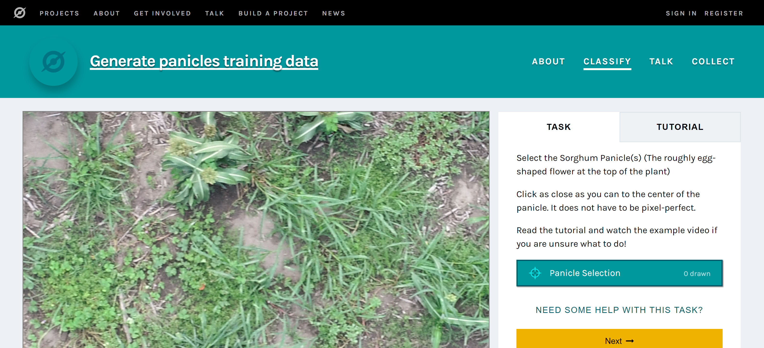
Photos and Training Data Data
Once Dr. Schnable gave me the photos (roughly 400 5400x3700 images), we used Zooniverse to collect info.
Data came from clicks on the center of flowers, as well as leaves and dirt.

Slide 8
Photos and Data
Roughly 10,000 clicks recorded on Zooniverse, including roughly 3400 sorghum flowers.
After some ad hoc analysis I assumed a 60x60 bounding box would be a good approximation for the sorghum flowers.
Generated a data set CSV of the following format
Filename, x1, y1, x2, y2, class
X1,y1 = top left corner of bounding box
X2,y2 = bottom right corner of bounding box

Slide 9
Object Detection Algorithms
There were many options, some better than others
CNN, RCNN, Fast-RCNN, Faster-RCNN
RetinaNet
MobileNet (Google)
Some algorithms built on the RCNN variant algorithms with improved results
Act as a suite of algorithms, all-in-one
Detectron (Facebook)

Slide 10
Object Detection Algorithms
RetinaNet was easy to use, and took in data in the format I already created.
It required more graphics card RAM than my laptop had, and my desktop’s power supply burnt out.
Holland Computing Center did not have deep learning library Keras.
Other libraries/algorithms had other issues with getting them up and running on a custom dataset.
Confusing data formats, high memory requirements, installation, etc.

Slide 11
Object Detection Algorithms
Recently I found a large, relatively easy to implement, collection of algorithms, implemented by the Tensorflow team.
https://github.com/tensorflow/models/
https://github.com/tensorflow/models/tree/master/research/object_detection
They require a Linux or Mac machine. (“Protoc” command line tool).
Implements RetinaNet, MobileNet, Faster-RCNN, and more.

Slide 12
Future Work
With access to a strong computer
Implement RetinaNet
With access to a weaker, Linux computer/VM
Implement Tensorflow’s implementation of MobileNet
Proceed from there.

